Slide 1

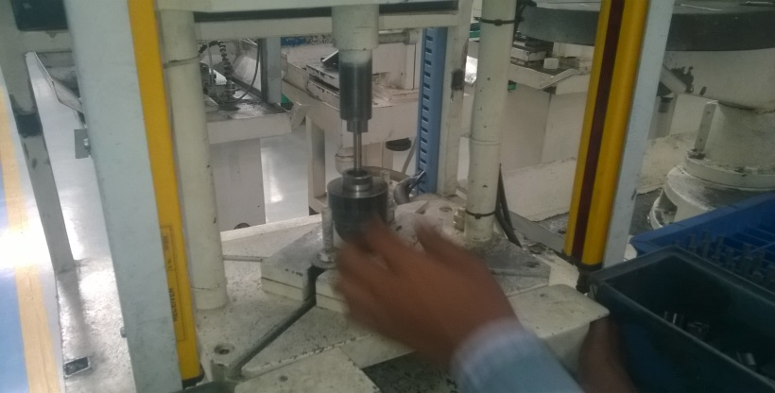
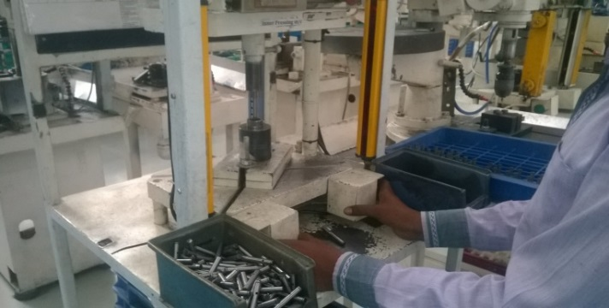
P15
KAIZEN NO :- 10
ACTIVITY
KK
QM
PM
JH
SHE
OT
DM
E&T
KAIZEN IDEA SHEET
TPM CIRCLE NAME: Achiever
LOSS NO. / STEP
DEPT :- MACHINE SHOP
RESULT AREA
P
Q
A,B,C
C
D
S
M
CELL:- Oil pump
CELL NAME:- A262/A107 Rotor
MACHINE / STAGE :- Press Machine
OPERATION :- Shaft Pressing.
KAIZEN THEME : To Eliminate Accident .
IDEA :- Cycle Start Button to be Modify.
Problem / Present Status :- In A262 Rotor Assembly Operators Finger get Damage while operator enter his hand during running Cycle..
COUNTERMEASURE:-
1.Cycle Start Button to be Modify as till operation will complete operator need to keep Pressing Cy. Start Button. If Hand removed from button cycle is Reset & Cylinder goes up.
BENCHMARK
Minor Accident
TARGET
Zero Accident
KAIZEN START
05.04.2016
TDC
06.04.2016
KAIZEN FINISH
TEAM MEMBERS :
1.Ramesh Thanvi ,Yuvraj Desai.
BENEFITS :-
1 Accident Chance Eliminate.
After
KAIZEN SUSTENANCE
RESULT :-
Accident Chance Eliminate.
Safe For Operator.
WHAT TO DO:- Cy. Start button Verify in start of Sheet.
HOW TO DO:- Point to be Added in JH Sheet.
WHY - WHY ANALYSIS :-
Why1 :- In A262 Rotor Assembly Operators Finger get Damage.
Why2:- Operator enter his hand during running Cycle.
Why3 :- Once Cy. Start button Press, Operator can Remove His Hand & engage in Other activity.
Why4 :- Current weak Design Concept of Cy. Start Button.
ROOT CAUSE : Current weak Design of Cy. Start Button.
REGISTRATION NO. & DATE : 06.04.2016
SCOPE & PLAN FOR HORIZONTAL DEPLOYMENT
REGISTERED BY :- Ramesh Thanvi
SR.
NO.
CELL
TARGET
RESPONSIBILITY
STATUS
MANAGER’S SIGN :- D. Y. Pawar
1
D.C
20.5.16
Yuvraj Desai
Complete

